Slide 1

Web Colors

Slide 2
Web Colors Using CSS
Thus far, we have set our text and background colors using actual color names, such as:
.example {
background-color: gray;
color: red;
}
In CSS 2.1, there are just 17 color names available. CSS3 expanded this number to 140, but even this amount of variety is insufficient to build a custom website.
Let's see now how we can create our own precise colors, with the number of possible shades running into the millions.

Slide 3
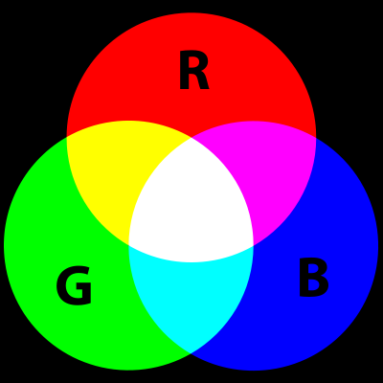
RGB Colors
To build custom colors, we mix specified amounts of the additive primary colors of red, green, and blue (often abbreviated as RGB).
There are 256 available shades for each of red, green, and blue.
That creates 256 X 256 X 256 = 16.7 million possible combinations!

Slide 4
RGB Hex Codes
We specify the mixtures of red, green, and blue by using what is known as a Hex code:
#12AF30
How much RED?
How much GREEN?
How much BLUE?
A Hex code is always preceded by the pound sign (#) and always lists the colors in the order of red, then green, then blue.

Slide 5
Understanding Hex Codes
For those who have never seen the hex (hexadecimal) format before, it can be confusing at first. In reality, it's fairly straightforward:
Base 10 (Decimal System):
Base 16 (Hexadecimal System):
0
1
2
3
4
5
6
7
8
9
0
1
2
3
4
5
6
7
8
9
A
B
C
D
E
F
Lowest Possible Digit
Highest Possible Digit
It's often helpful for newcomers to hexadecimal to translate the letters in their mind to Base 10 numbers. So A=10, B=11, C=12, D=13, E=14, and F=15.

Slide 6
Two Character Hex Codes
For each color (red, green, blue), we have two hexadecimal characters (digits) to set a value. The first character represents how many 16s are in the number and the second character represents how many 1s:
Hexadecimal:
Decimal:
00
01
0A
0F
10
1F
2A
7D
AA
F1
FF
0
1
10 (zero 16s and ten 1s)
15 (zero 16s and fifteen 1s)
16 (one 16 and zero 1s)
31 (one 16 and fifteen 1s)
42 (two 16s and ten 1s)
125 (seven 16s and thirteen 1s)
170 (ten 16s and ten 1s)
241 (fifteen 16s and one 1)
255 (fifteen 16s and fifteen 1s)
This two-character hexadecimal format allows for 16 X 16 = 256 possibilities, ranging from the lowest value of 00 to the highest value of FF.
If we set the value of red to be 00, it would contribute no red at all. If we set it to be FF, it would contribute the maximum possible amount of red to the resulting color.

Slide 7
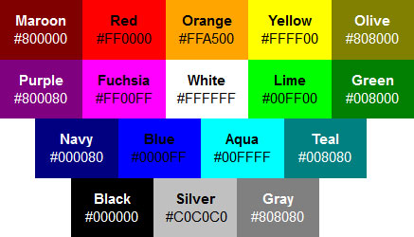
Example Hex Codes
If hexadecimal is still a bit confusing, don't worry. When we start using real-life examples, it will begin to make more sense. Here are the actual hex codes for the 17 standard colors in CSS 2.1:
As we study these hex codes, we can begin to see the logic of mixing lower and higher amounts of red, green, and blue to result in the given color.
Hex codes can use uppercase or lowercase letters A through F, or even a mix between the two. As uppercase letters are more commonly used, we'll standardize on them in this course.

Slide 8
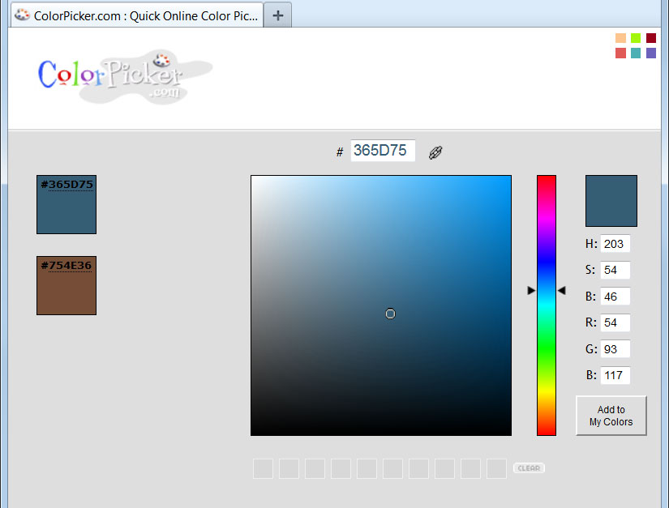
Finding Hex Codes
Many applications and websites offer tools to help us find and select color codes. Colorpicker.com is a free website and very simple to use:
Hex code displays here, ready to be copied and pasted.
Slide the arrows up and down to browse the color spectrum.
Click on any spot in the color picker area to produce the hex code for that specific shade.

Slide 9
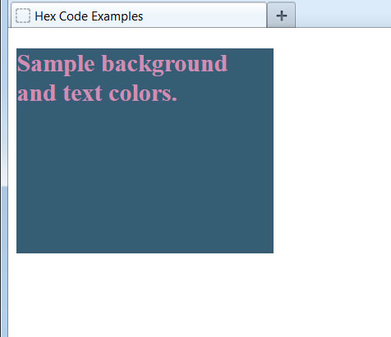
Using Hex Codes in CSS
Let's use the Hex code we just generated from the color picker website and set it as the background color for a <div> element. We'll set a different, contrasting color for the text:
<style type="text/css">
.example {
background-color: #365D75;
color: #D08EB4;
width: 250px;
height: 200px;
}
</style>
...
<div class="example">
<h2>Sample background and text colors.</h2>
</div>
Remember to start the Hex code with the pound sign. If this is omitted, CSS will completely ignore the color declaration.

